Slide 1

Welcome to Year 5!
Notes:
Speaker notes:
Thank people for joining
St Nic’s is a special place – if you ask people why it’s special they’ll give you lots of answers
What we’ve done is pull all of these answers together to define our vision, mission, and values
This is good practice for all schools (and organisations) and particularly for us as a church school
It’s taken a while because of COVID but that’s given us a chance to hear lots of different views and feedback and reflect on why we’re here and how we make a difference to our community
It’s not new – most of it should be very familiar, just written so that we can remember it easily and apply it to our day to day teaching and learning
Other notes:
Not pursuing the “ship” idea as the feedback was that it was too complicated
Not pursuing the “Jesus calms the storm” story as it doesn’t fit with our narrative (as this presentation shows)
Want something that is straightforward, memorable, and applicable to our community

Slide 2
Year 5 staff
Class.11
Miss Lovegrove and Ms Shackell (Tuesdays)
Class.12
Mrs Crask and Ms Shackell (Wednesdays)
Support Staff
Mrs Delaney
Mrs G
Mrs Collins
Mrs Puckey
Mrs Milne
PPA Staff
Mrs Leat
Mrs Harrop

Slide 3
Daily routine
8:35 – Doors open – morning activity
8:45 – Register is taken
9:00 – 10:00 – Lesson 1 – usually Maths
10:00 – 11:00 –Lesson 2 – usually English
11:00-11:20 – Break
11:20-12:20 – Lesson 3 and 4 – usually Guided Reading and Spelling
12:20-1:15 – Lunch
1:15 – 1:30 – Mastering Number
1:30-2:30 – Topic/Science
2:30-3:00 – PSHE/RE
3:00 – 3:15 - Story

Slide 4
Year 5 topics throughout the year
Autumn 1 –Frozen Kingdom
Autumn 2 – Frozen Kingdom
Spring Term – Off With Her Head (Tudors)
Summer 1 – Time Travellers
Summer 2 – Hola Mexico

Slide 5
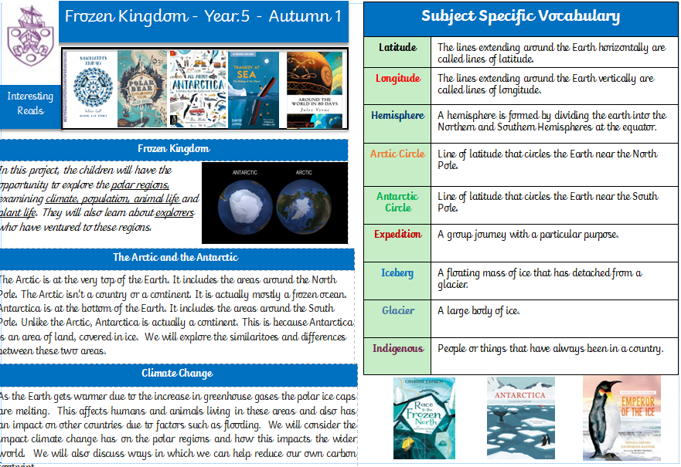
Knowledge Mat

Slide 6
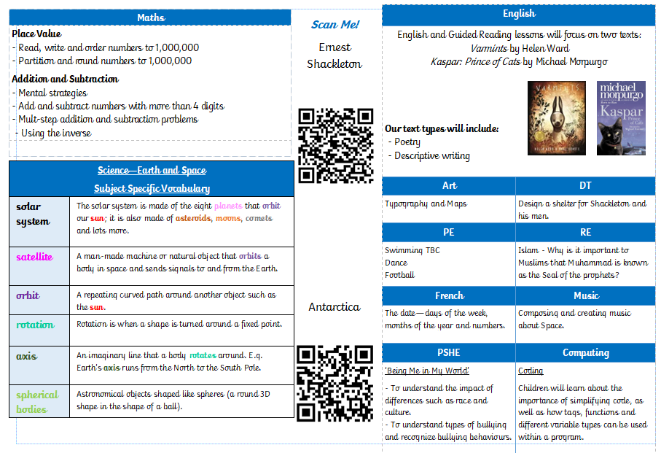
Knowledge mat

Slide 7
PE
- Year 5 PE day Wednesday – arrive in PE kit
- Swimming will take place later in the term – dates are to be confirmed but it is likely to be an ‘intensive’ week with the children swimming every day.

Slide 8
What your child needs
Water bottle – with water in it.
Jacket suitable for the weather
Reading book and record
Snack for morning break – this should be fruit or healthy alternative
Pencil cases are NOT required
Please do not send in toys from home.

Slide 9
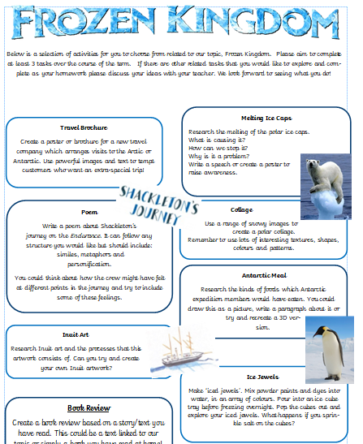
Homework
Maths homework
set every Friday and is due in the following Friday
marked in class.
choose challenge from Sets A, B or C or for a house point can complete all three sets!
Topic homework
due in on Monday 19th October
homework celebration for the children in school during that week.
Aim to complete 3 activities over the course of the term
Spellings
- Homework will be set on Spelling Shed on Fridays – 5 games to be completed by the following Friday.

Slide 10
Reading
Reading records and reading books have been sent home.
It is expected that your child will read regularly at home and complete their reading record to show that they have read.
Reading books and records must be in school every day and books can be changed at any time through the week.
Any form of reading is wonderful so please encourage your child to read widely alongside their school book.

Slide 11
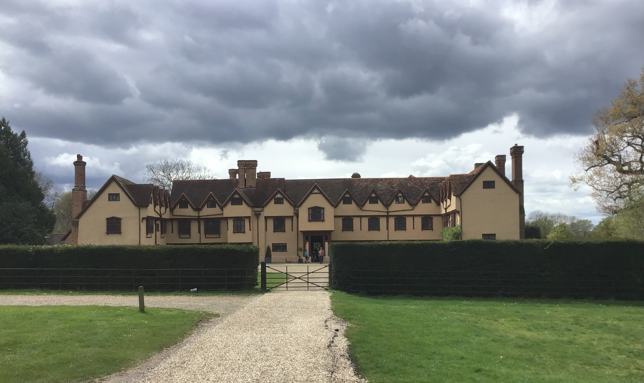
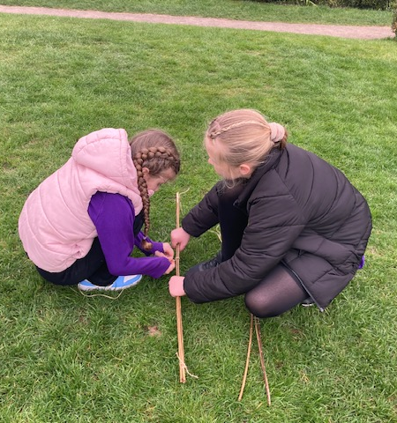
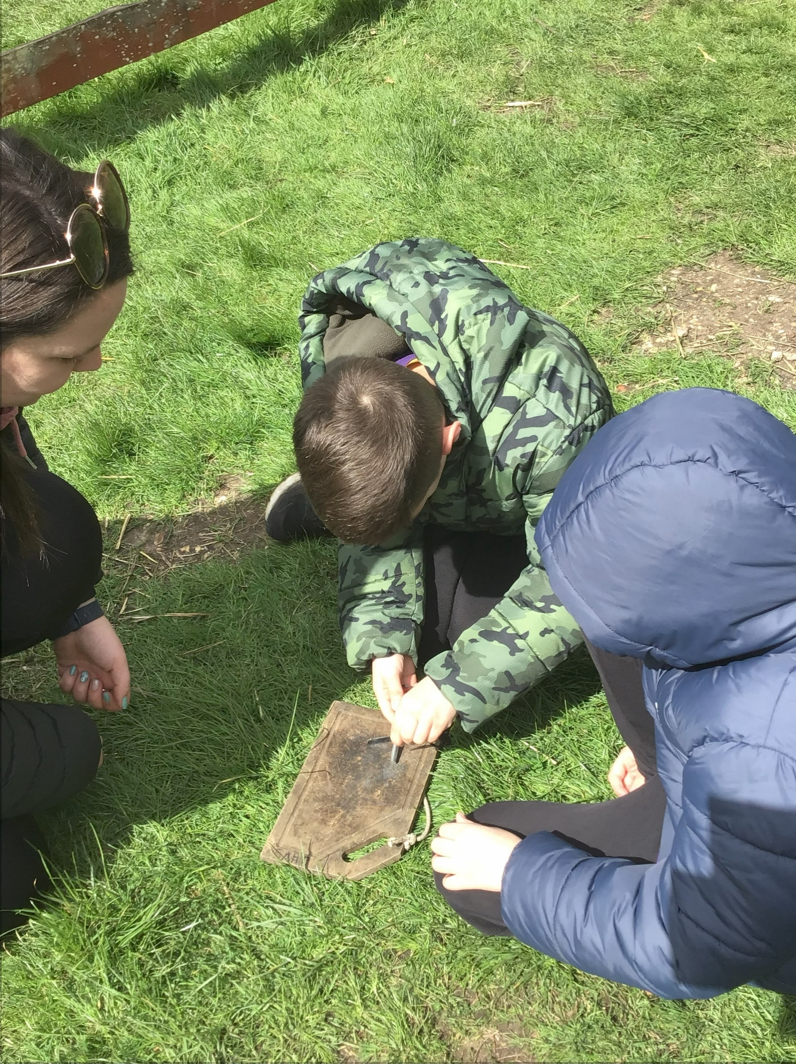
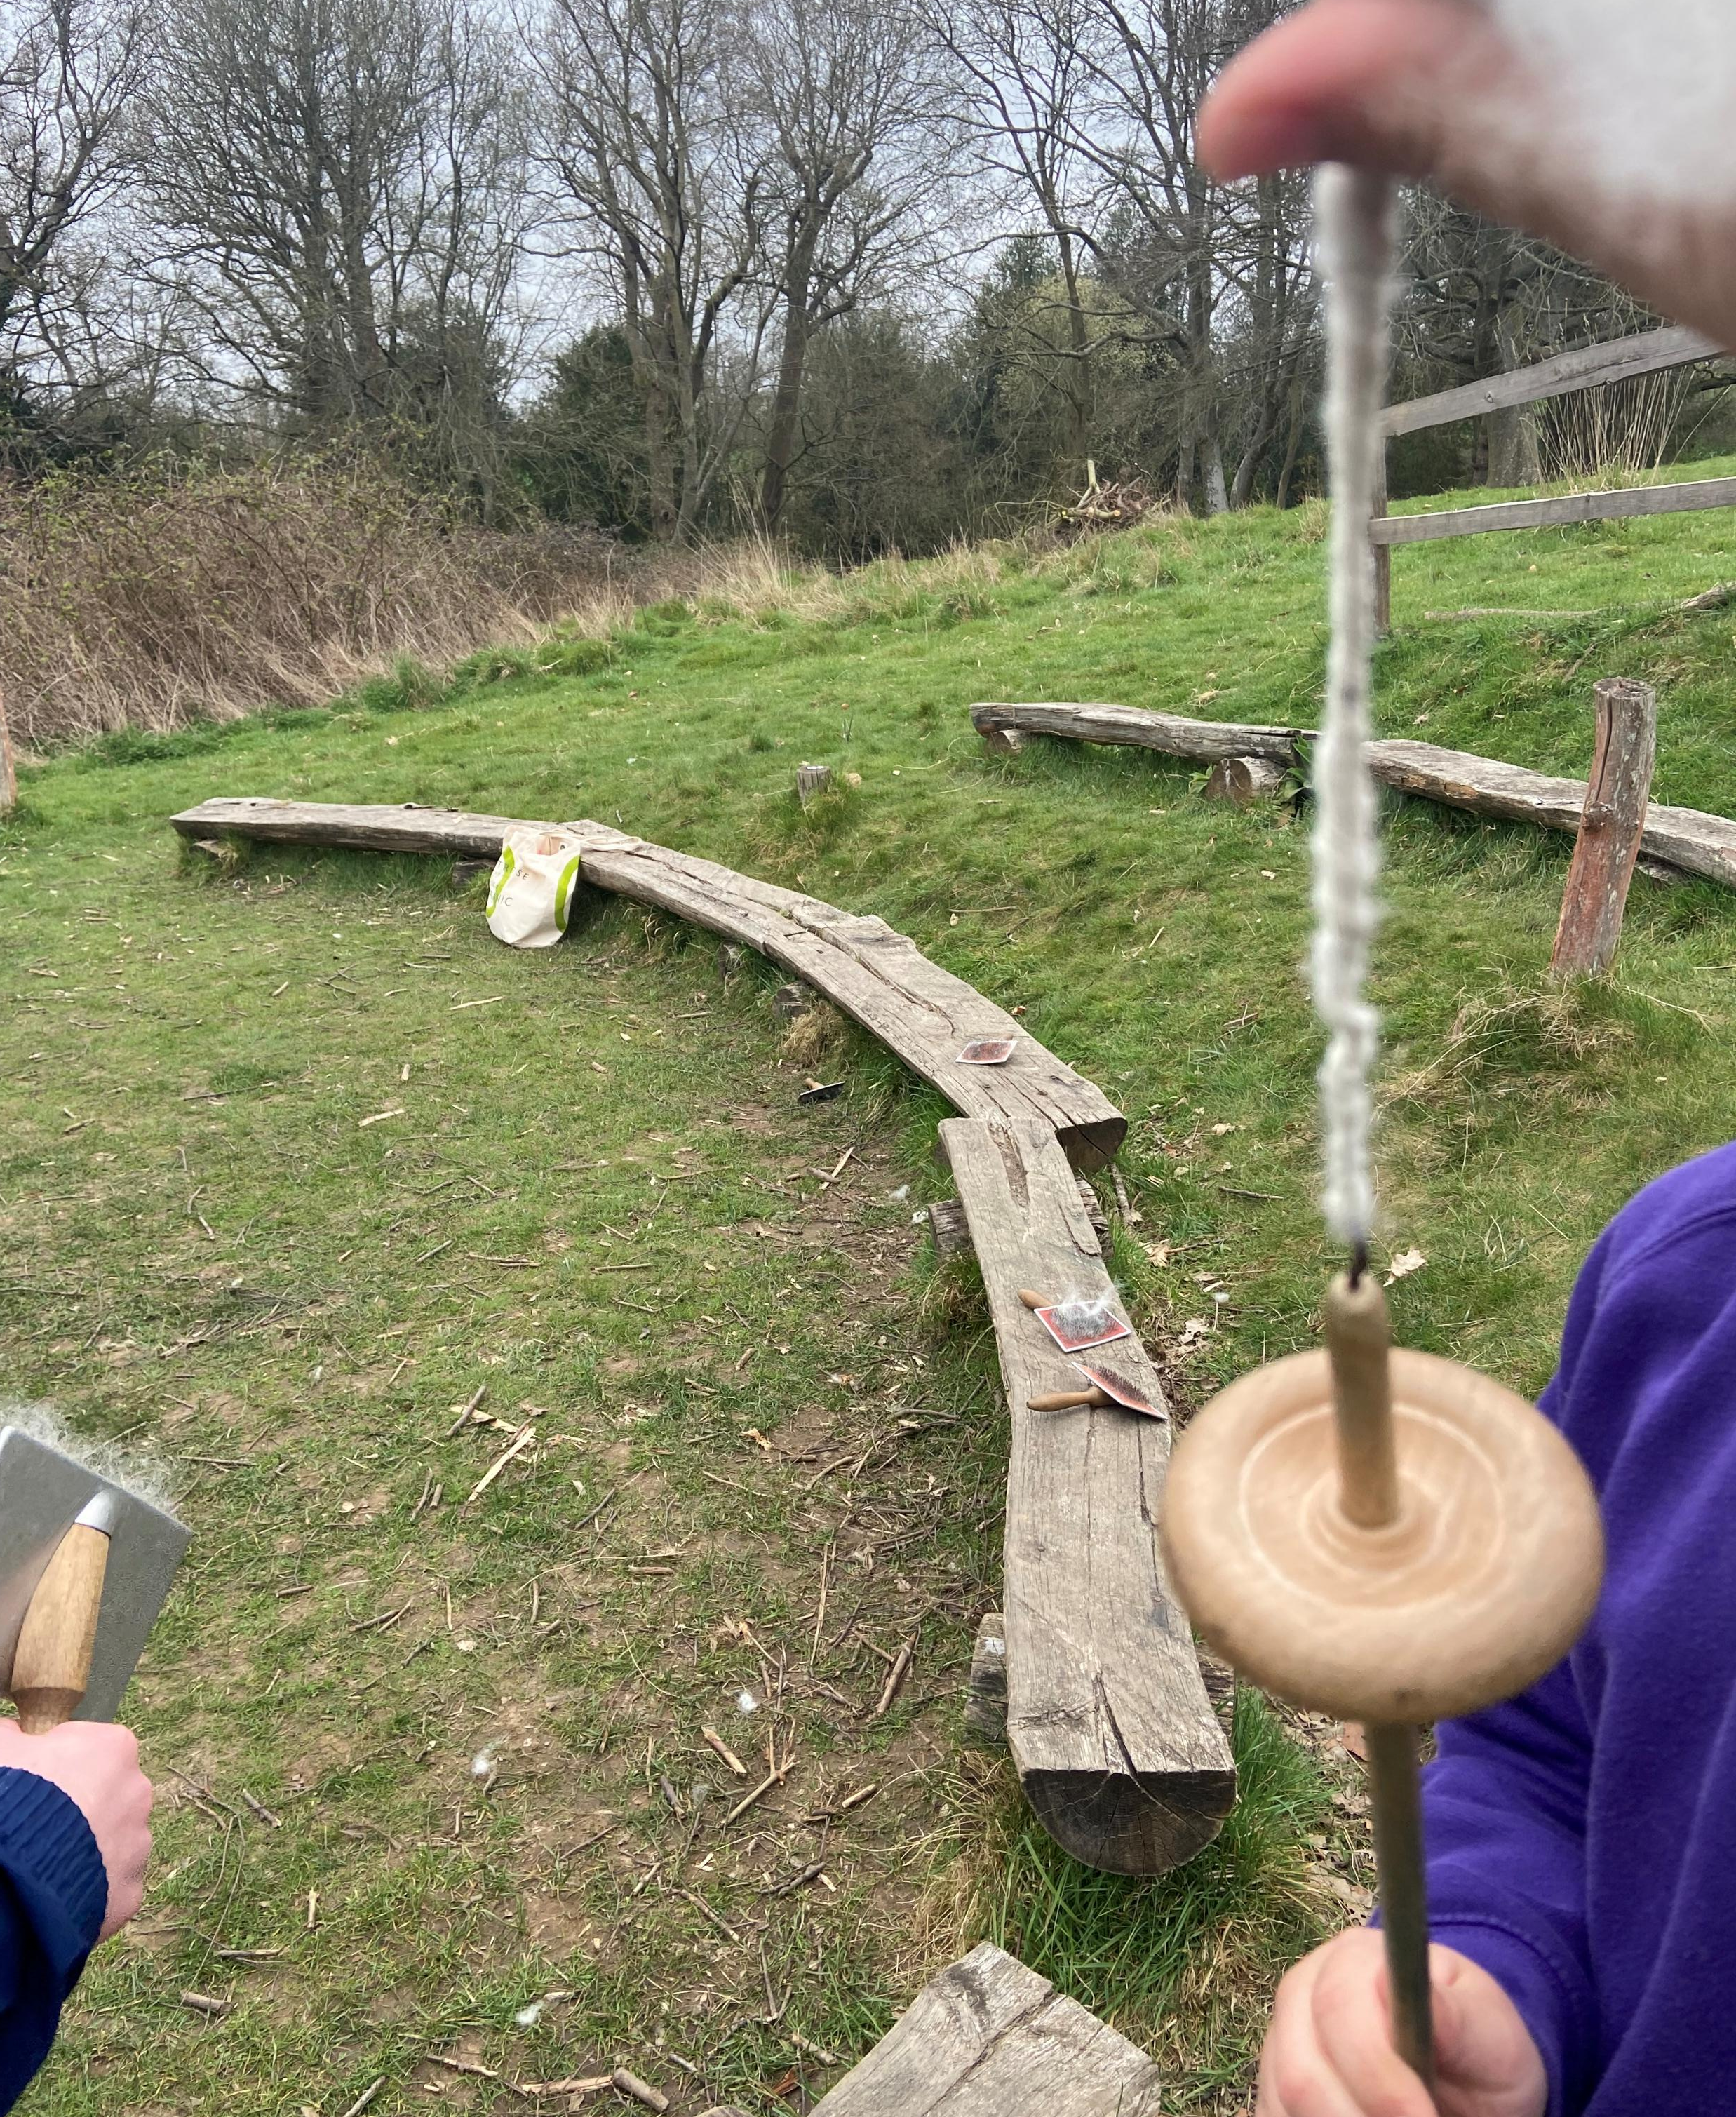
School trips in year 5
Ufton Court
- Links to Tudor topic.
- Trip tends to be between February half term and the Easter holidays.
Full day trip (typical school hours)
Range of activities including:
- Crime and Punishment role play
- Tudor games
- Exploration

Slide 12
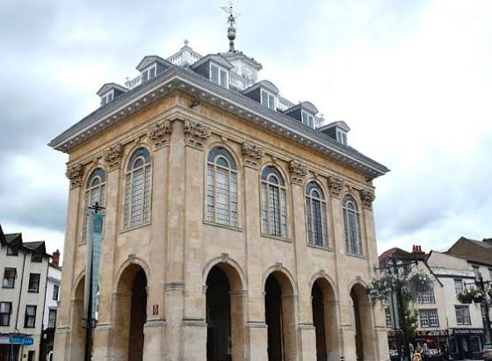
Abingdon museum
Trip to Abingdon Museum in April with a workshop focusing on ‘A Monk’s Life’ linking to work we carry out based on Abingdon Abbey.

Slide 13

Any questions?

