Slide 1

Welcome to Year 5!
Notes:
Speaker notes:
Thank people for joining
St Nic’s is a special place – if you ask people why it’s special they’ll give you lots of answers
What we’ve done is pull all of these answers together to define our vision, mission, and values
This is good practice for all schools (and organisations) and particularly for us as a church school
It’s taken a while because of COVID but that’s given us a chance to hear lots of different views and feedback and reflect on why we’re here and how we make a difference to our community
It’s not new – most of it should be very familiar, just written so that we can remember it easily and apply it to our day to day teaching and learning
Other notes:
Not pursuing the “ship” idea as the feedback was that it was too complicated
Not pursuing the “Jesus calms the storm” story as it doesn’t fit with our narrative (as this presentation shows)
Want something that is straightforward, memorable, and applicable to our community

Slide 2
Year 5 staff
Class.11
Miss Lovegrove
Miss Rand (Wednesdays)
Class.12
Miss Dolman
Support Staff
Mrs Haines / Mrs Walker
Mrs Collins
Mrs O’Dea
Miss Galsworthy
PPA Staff
Mrs Leat
Mrs Harrop

Slide 3
Year 5 topics throughout the year
Autumn 1 – Stargazers (Space)
Autumn 2 – Frozen Kingdom
Spring Term – Off With Her Head (Tudors)
Summer 1 – Time Travellers
Summer 2 – Hola Mexico

Slide 4
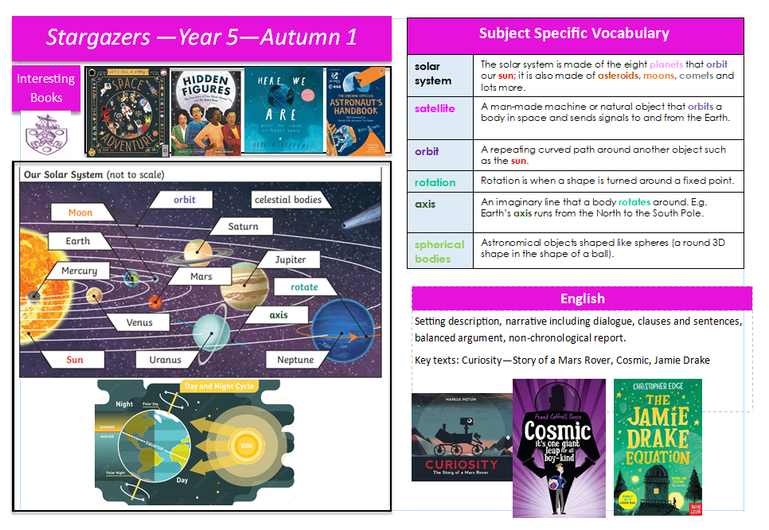
Knowledge Mat

Slide 5
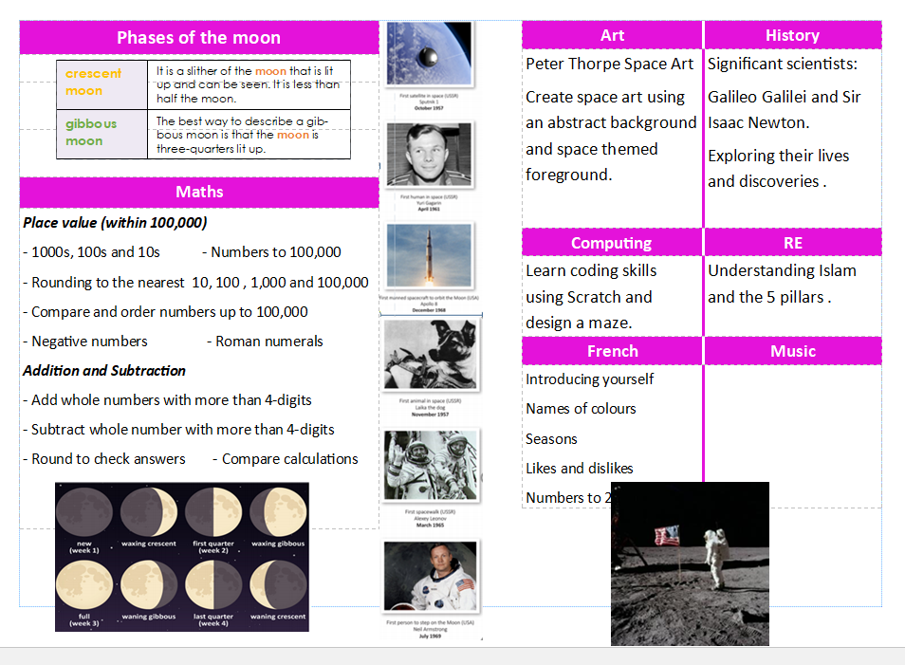
Knowledge mat

Slide 6
PE
- Year 5 PE day Wednesday – arrive in PE kit
- Swimming day Friday
Arrive in PE kit, bring swimming kit

Slide 7
swimming
Friday 19th September – Only Class.12
Friday 26th September - Only Class.11
Friday 3rd October 2026 – Friday 30th January 2026 – Both classes swimming
(No swimming Friday 19th December as last day of term)

Slide 8
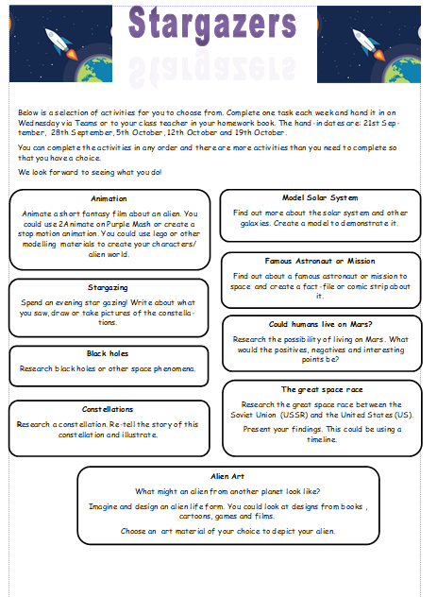
Homework
Given out on Friday, due following Wednesday
Topic menu – selection of activities to choose from
Maths homework
Can be submitted on Teams

Slide 9
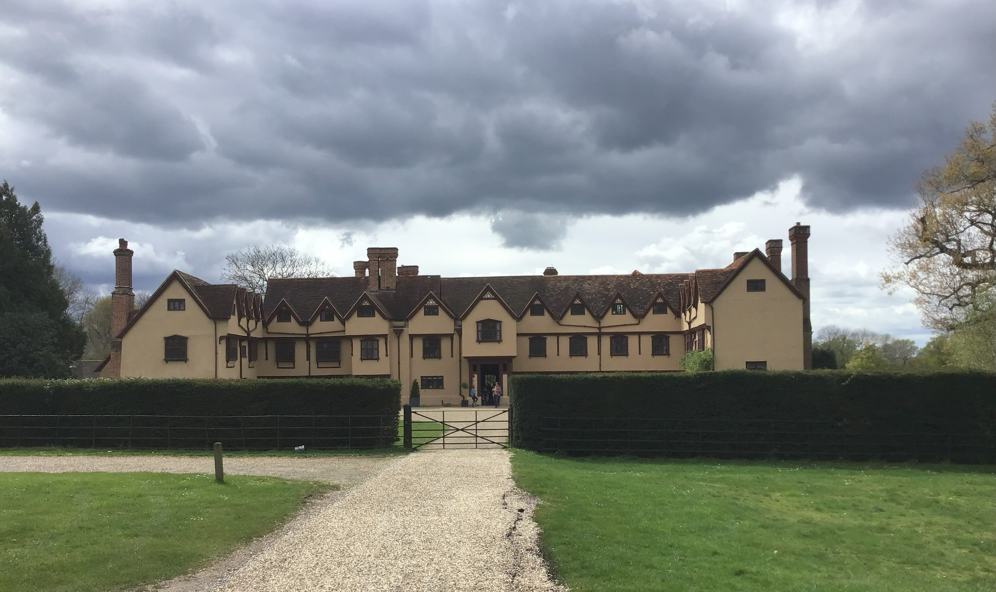
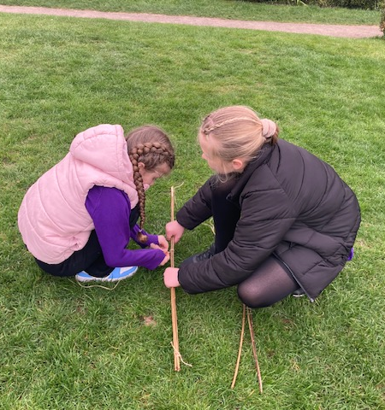
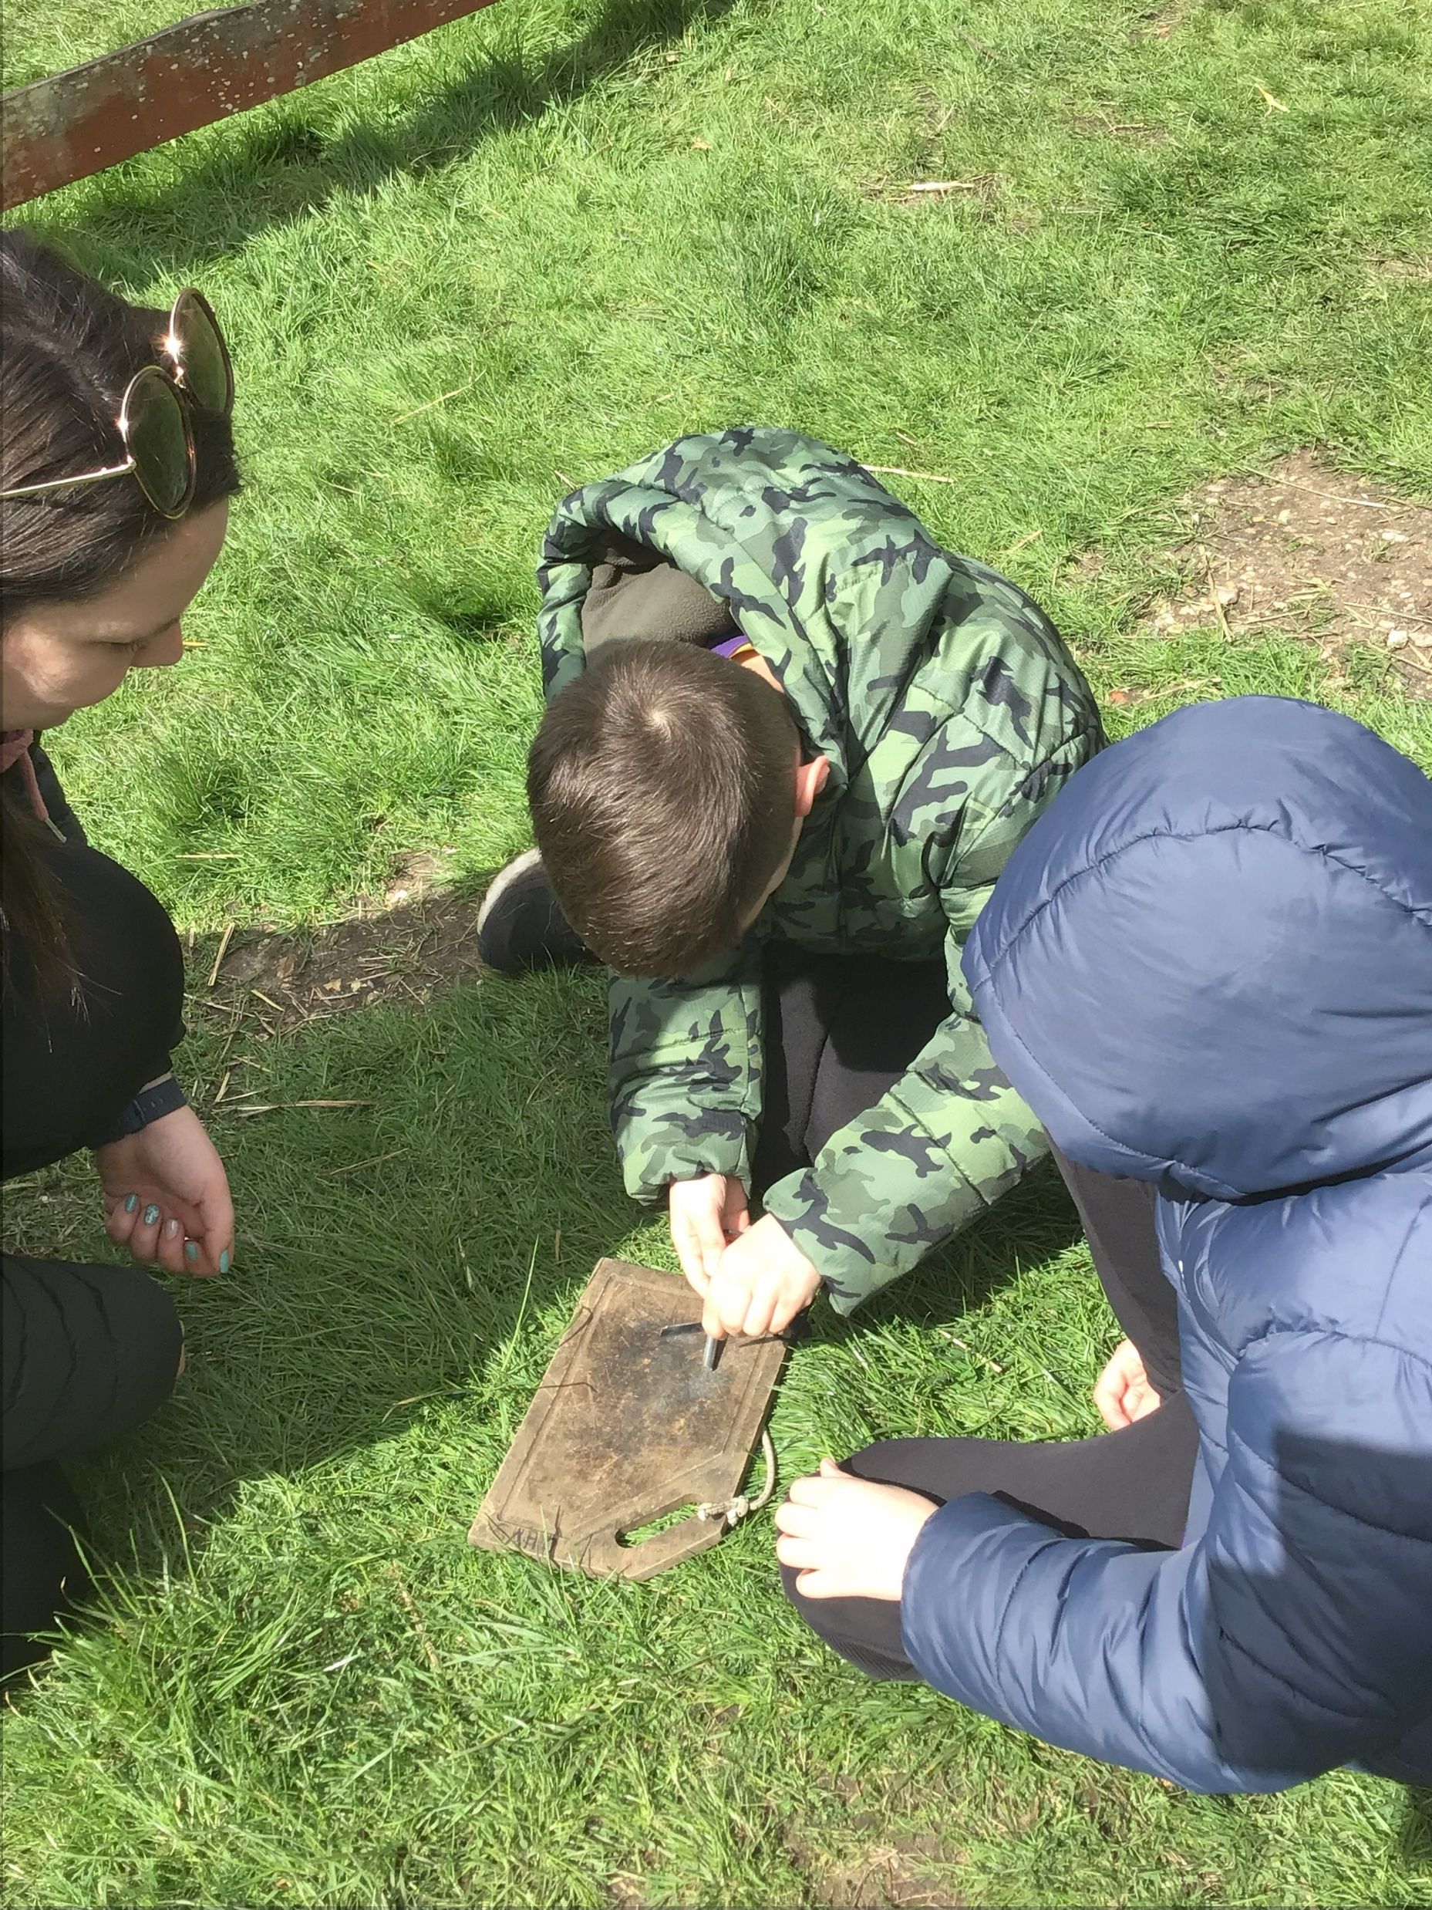
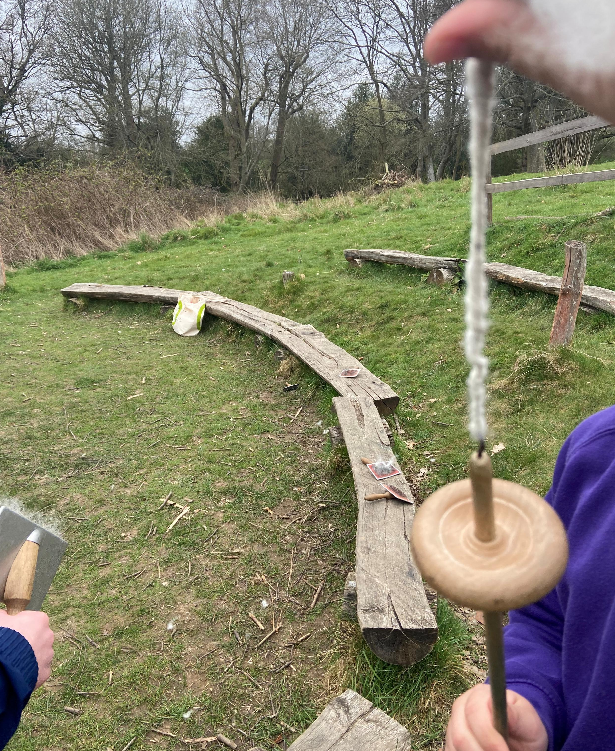
School trips in year 5
Ufton Court
- Links to Tudor topic.
- Trip tends to be between February half term and the Easter holidays.
Full day trip (typical school hours)
Range of activities including:
- Crime and Punishment role play
- Making bow and arrows
- Learning skills from daily Tudor life

Slide 10

Any questions?

