Slide 1

Welcome to Year 6!
Please feel free to look through this term’s knowledge mat while wait for everyone to arrive.
Mrs wilcox and Mrs Logan
Notes:
Speaker notes:
Thank people for joining
St Nic’s is a special place – if you ask people why it’s special they’ll give you lots of answers
What we’ve done is pull all of these answers together to define our vision, mission, and values
This is good practice for all schools (and organisations) and particularly for us as a church school
It’s taken a while because of COVID but that’s given us a chance to hear lots of different views and feedback and reflect on why we’re here and how we make a difference to our community
It’s not new – most of it should be very familiar, just written so that we can remember it easily and apply it to our day to day teaching and learning
Other notes:
Not pursuing the “ship” idea as the feedback was that it was too complicated
Not pursuing the “Jesus calms the storm” story as it doesn’t fit with our narrative (as this presentation shows)
Want something that is straightforward, memorable, and applicable to our community

Slide 2
Timetable
Literacy, Maths, Spelling and Reading each morning Mon-Thurs
P.E. Mon pm
Science/Project Tues/Weds pm (Mrs Mathers in class 14 some Tues)
Music, PSHE and French Thurs pm (Mrs Leat and Mrs Harrop)
Friday (Miss Rand in class 13) Maths, SPaG, Computing, RE, Art

Slide 3
Year 6 topics throughout the year
Autumn 1 – Dynamic Dynasties (China and Shang Dynasty)
Autumn 2 – Blood Heart (Circulatory system)
Spring 1/2 – Britain at War (World War 1 and 2)
Summer 1 – Darwin’s Delights (Evolution and Inheritance)
Summer 2 – I.D. (Identify and Transition to secondary)

Slide 4
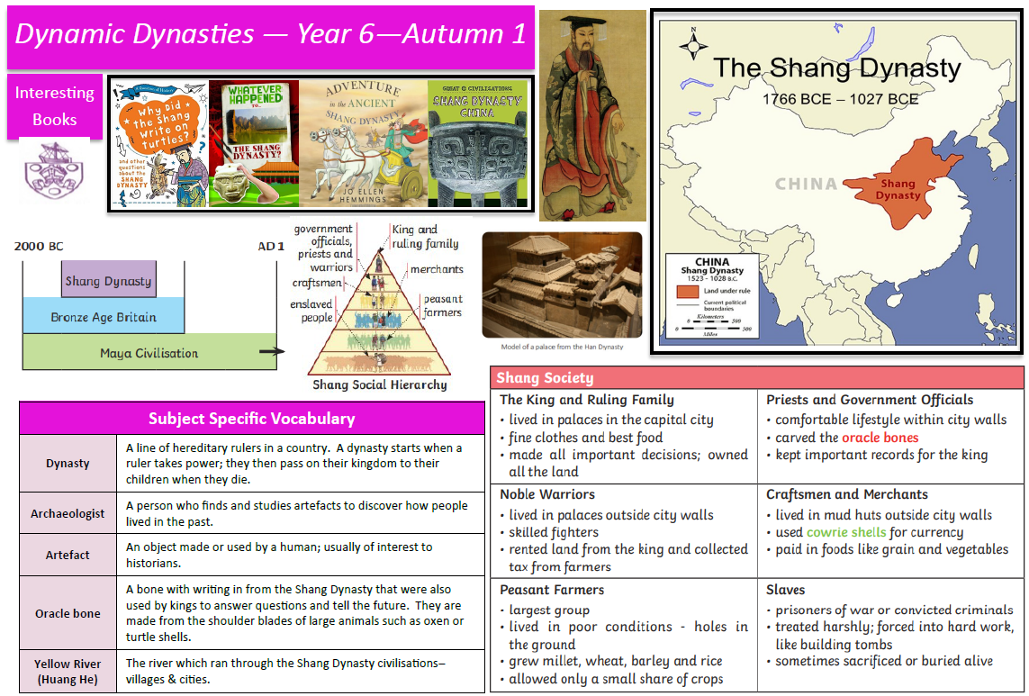

Slide 5
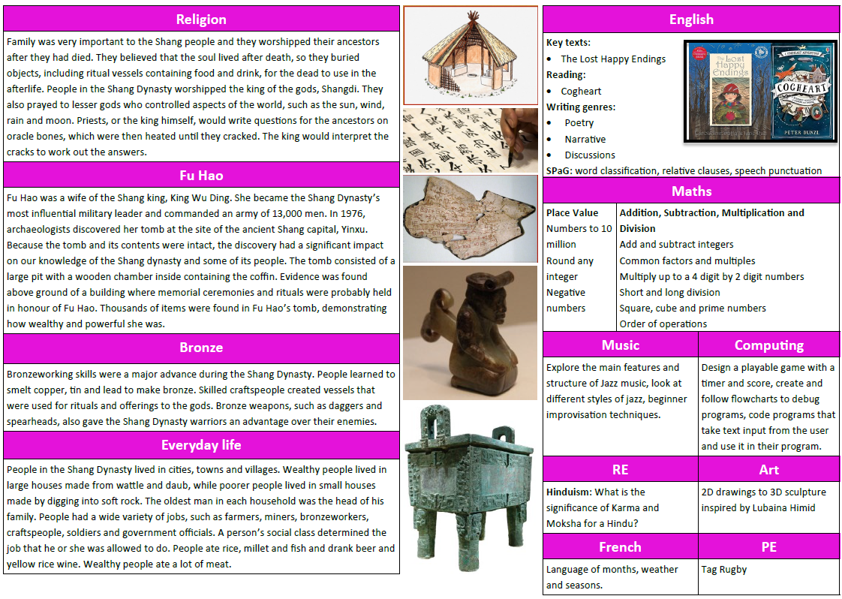

Slide 6
Homework
Given out on Wednesday, due in Monday
Topic menu – selection of activities to choose from
Maths homework
Submitted on TEAMS
SPaG quiz after Christmas (until SATs)

Slide 7
Year 6
“Disco door”
Prefect duties
Mobile phones
Kilvrough
Enterprise project
SATs

Slide 8
SATs
Monday 12th May – Thursday 15th May 2025
Monday – SPaG Paper 1 and 2
Tuesday – Reading
Wednesday – Maths Paper 1 and 2
Thursday – Maths Paper 3
SATs breakfast

Slide 9

Any questions?

Slide 10
Kilvrough Manor
October 7th – 11th

Slide 11
Aims
Team building
Make new friendships
New experiences
Build confidence & overcome fears
Develop growth mindset
Develop problem solving skills

Slide 12
The week…
Is split into three parts

Slide 13
Part one:
Monday:
Journey to Wales
The manor
Introductory activities

Slide 14
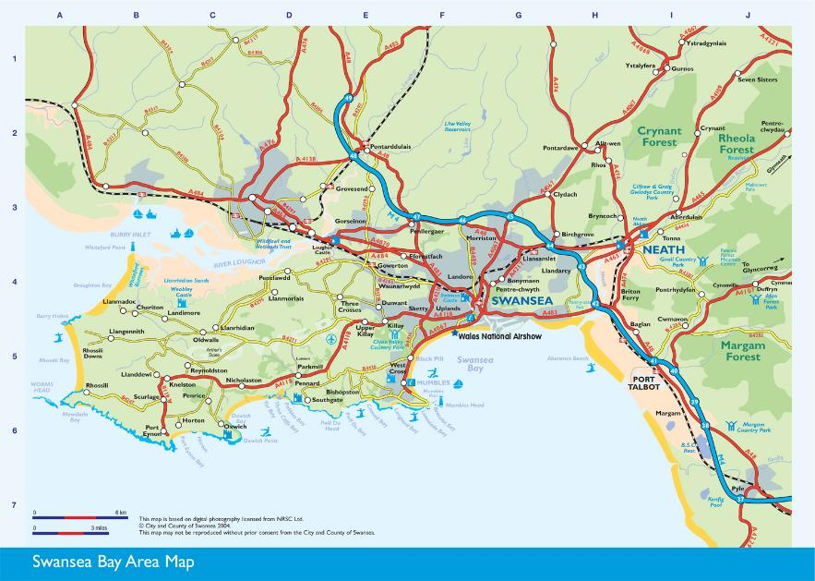
Arrival- Where is Kilvrough Manor?
Kilvrough

Slide 15
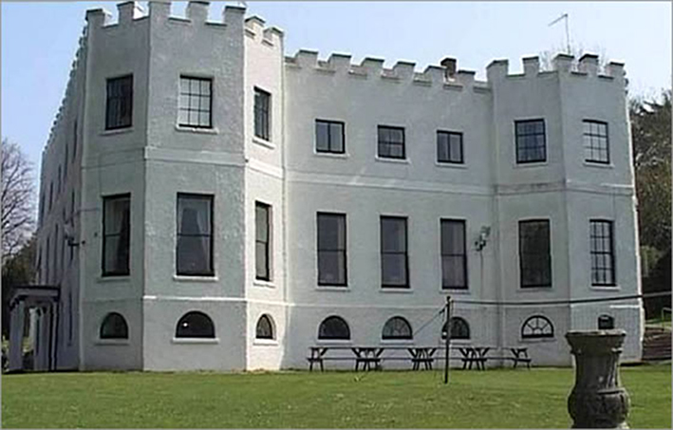
Getting to know the manor,
finding dormitories,
making beds!

Slide 16
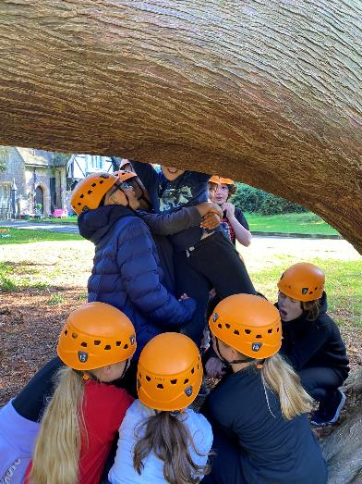
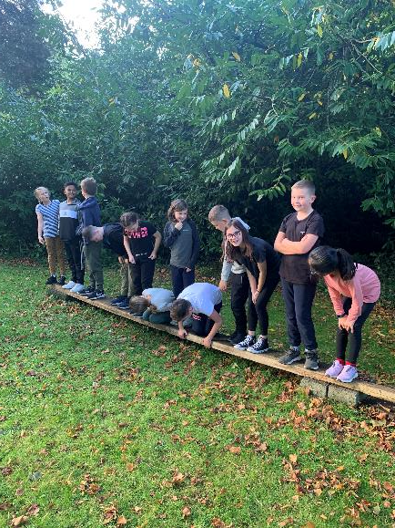
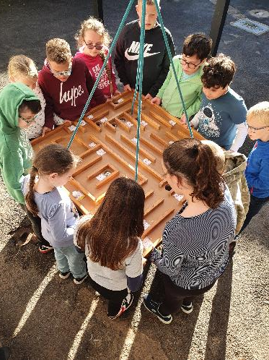
Team building

Slide 17
Part two:
Tuesday – Thursday:
Main activity days
Each group will do one activity each day

Slide 18
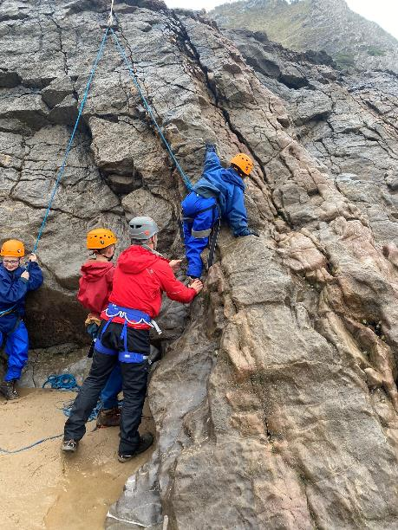
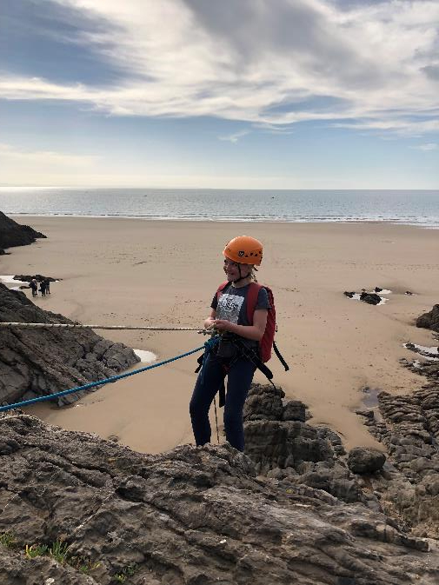
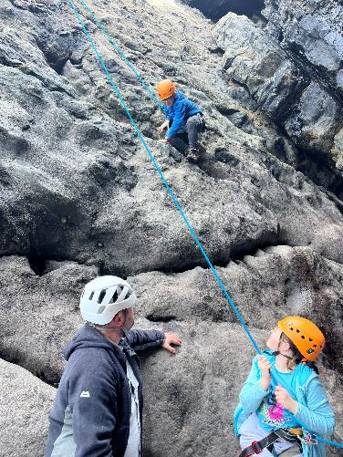
Climbing

Slide 19
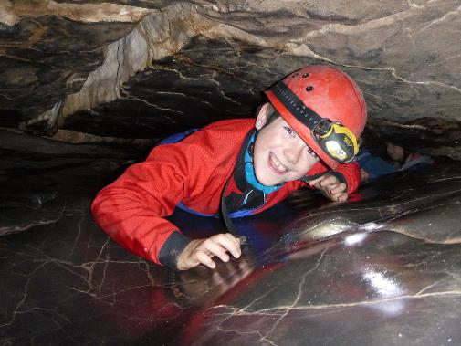
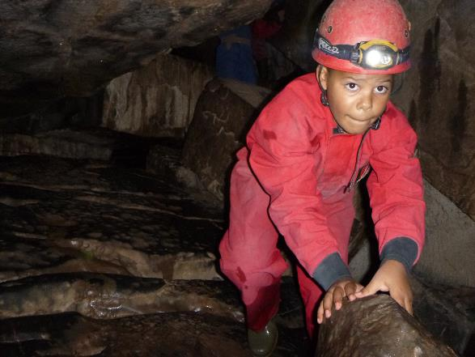
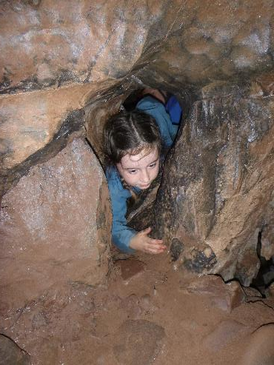
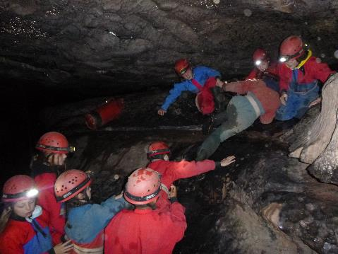
Caving

Slide 20
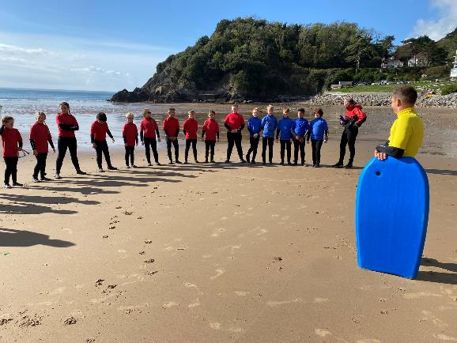
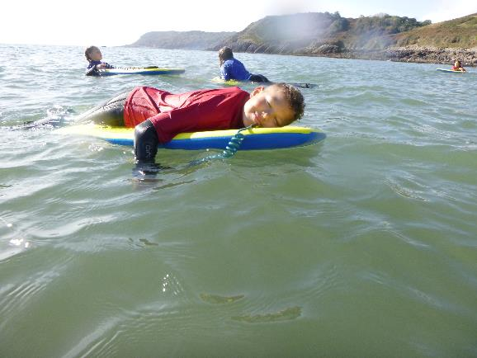
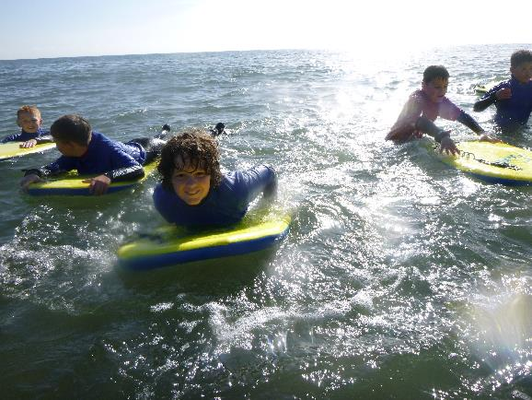
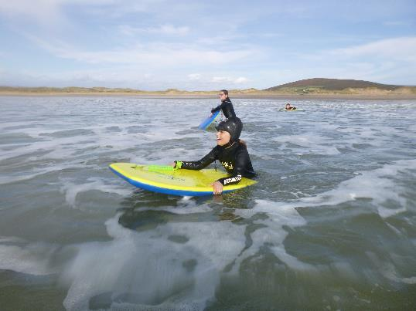
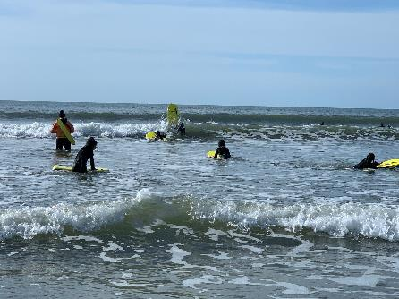
Body boarding

Slide 21
Part three:
Friday:
Final activity
Coming home!

Slide 22
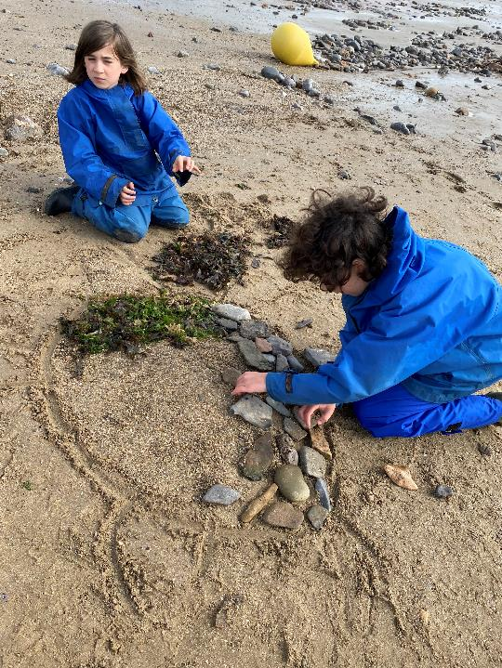
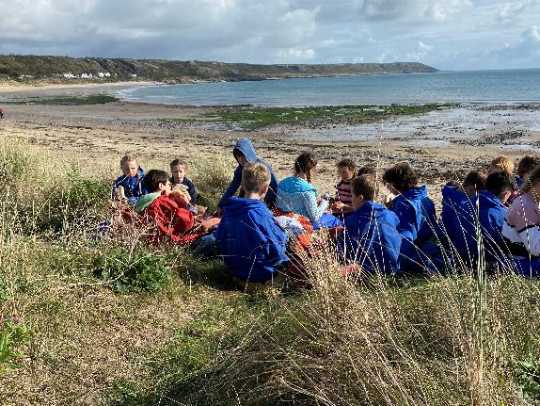
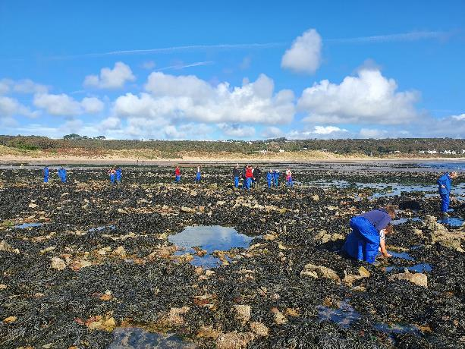
Beach day

Slide 23
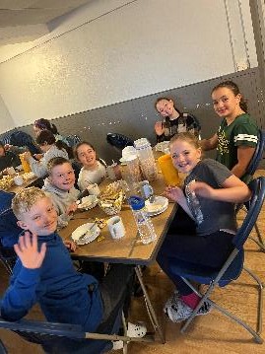
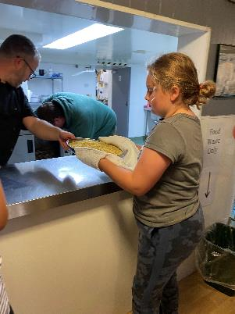
Food
Breakfast – cereal, juice, toast, sometimes bacon/sausage sandwich
Packed lunch – choice of filling, crisps, fruit, snack
Hot dinner – vegetarian and meat option
Lots of carbohydrates – rice, pasta
Duties in the dining room

Slide 24
Dormitories
Boys and girls in separate areas
Dormitories vary from 4 – 9 people
Children will have at least one person in their dormitory they would choose to be with
Dormitory inspections will take place everyday
Children will be expected to bring duvet covers and pillow covers

Slide 25
Kit list
No valuable items
Two pairs of trainers/shoe – wet/dry
Expect clothing to get very dirty
Name labels
Sun cream
Water bottle

Slide 26
Other information
Leave early on the Monday morning - 8am
Stop at the services on the way there and back
No electronic games or mobile phones on the residential
School staff member in each group
Behavioural expectations
Return to school early evening

