Slide 1
Developing a growth mindset culture in school
We all need to move away from having a fixed mindset

Slide 2
What is growth mindset?
Carol Dweck – a Professor of Psychology
Growth mindset – about cognition – about enjoying learning and being successful as a learner.

Slide 3
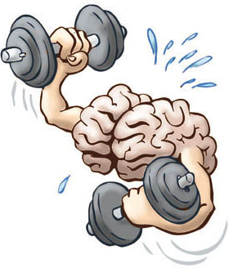
Your brain is like a muscle
When you train your muscle, the muscles will train based on the amount of EFFORT you put into making that change.
This is proven to be the same with your brain.
THE MORE EFFORT YOU PUT
INTO YOUR LEARNING, YOUR
BRAIN WILL CHANGE

Slide 4
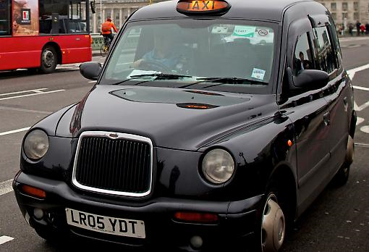
Black cab taxi training in London
How long do you think it takes to become a black cab taxi driver in London?
3 years
Taxi drivers need to be able to work out alternative routes mentally throughout the City to avoid excessive congestion.
The training was tested.
A driver’s brain development
Increased by 30% from the start to
the end of the training.

Slide 5
What is a mindset?
It is simply a BELIEF
about YOURSELF
Can relate to ability, faith, personality, talent

Slide 6
We all have a mindset
Growth Mindset
Fixed Mindset
Intelligence and talent can go up or down
You think that intelligence and talent are fixed a birth
Many of us have a fixed mindset in some experiences and subjects and a growth mindset in others

Slide 7
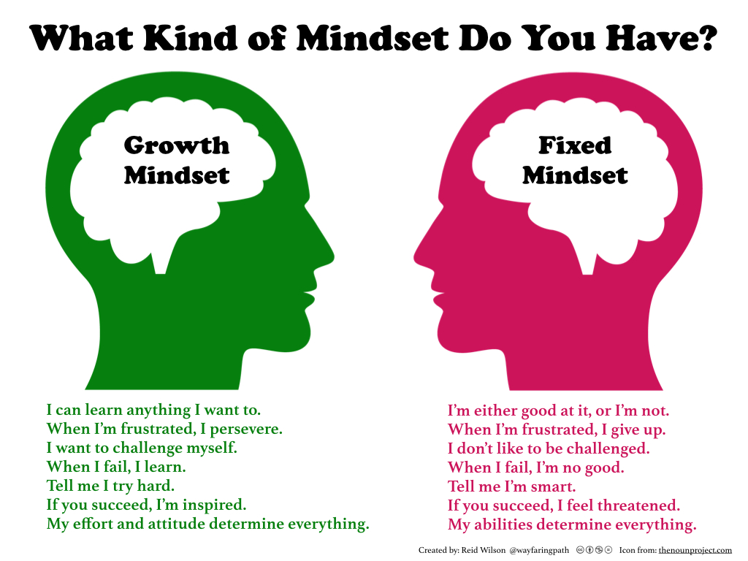

Slide 8
A Growth mindset begins with us all – what do we do when things become difficult?

Slide 9
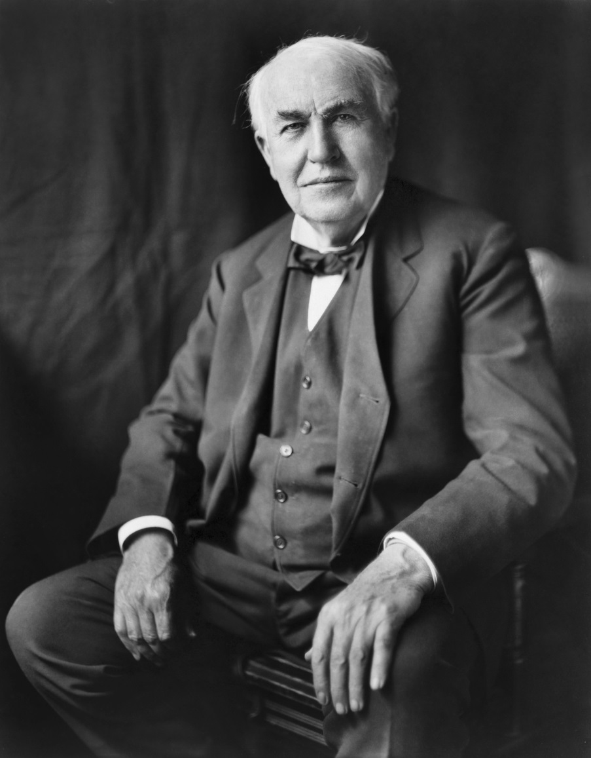
Some adult case studies of growth mindset
Who’s this?

Slide 10
Thomas Edison
“I have not failed. I’ve just found 10 000 ways that won’t work.”

Slide 11
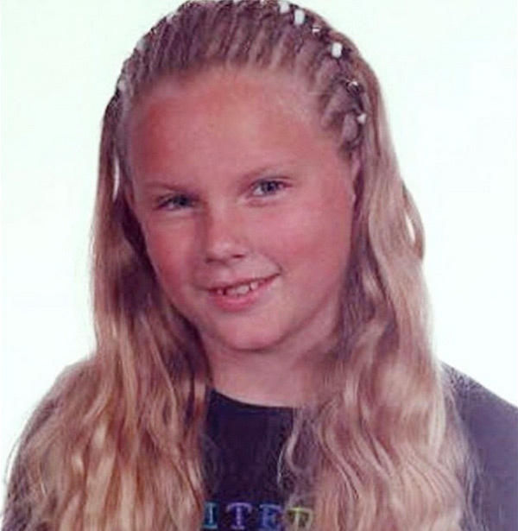
Who’s this?

Slide 12
Taylor Swift
She used an image of herself as a child to make people realise the journey she had taken over time.
She wanted people to understand that success didn’t happen over night.
She talked about her personal life and numerous failures and challenges she had to cope with. It was her 5th music album that made her successful.

Slide 13
Children are exposed to people who are at the pinnacle of their careers.
Katie Greves
Matt Gotrel

Slide 14
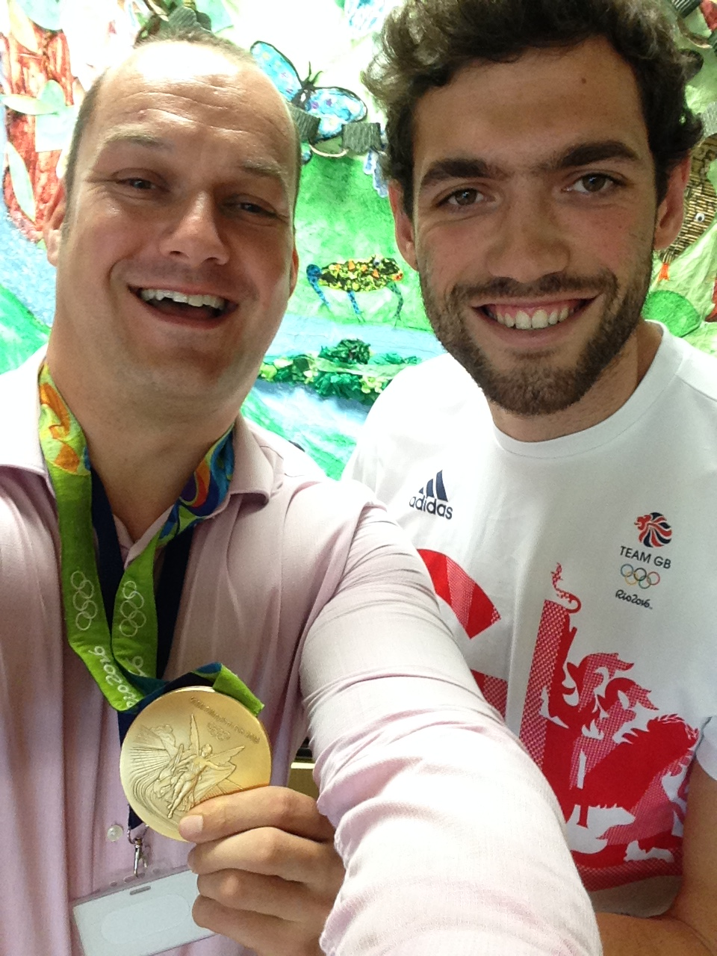

Slide 15
It all appears effortless and that it ‘just happened’. The reality of success is the zig zag road up a mountain.

Slide 16
Growth mindset focuses on a LEARNING GOAL
Fixed mindset focuses on PERFORMANCE GOALS
Students want to find out more
They want to play to the best of their abilities
It’s about the PROCESS rather than the END GOAL
Will aim for a particular goal
Will either achieve the goal or they won’t
Increased anxiety and frustration

Slide 17
Promoting learning goals
We all need to think about the process of learning and what is needed to master new things.
This year, in all aspects of the curriclum, is about developing:-
- PERISTENCE
- TRYING OUT DIFFERENT STRATEGIES
- REPETITION
- MAKING MISTAKES
- learning from TRIAL & ERROR

Slide 18
Where do we start?
School community to develop a language that regularly promotes a growth mindset
Displays around school that promote a growth mindset
Inspire using stories
Mental contrasting
Marvellous mistakes
Trial and improvement
Pay attention to working memory
Modelling, Prompting and Clueing
Editing and more editing
Engaging parents with growth mindset

Slide 19
Giving children growth mindset language
Effort Good mistakes
Challenge Grit
Perseverance Useful failure
Thinking Growth
Learning Trial and improvement
Feedback Thinking and Thinking
Decisions Reflection
Challenge Persistence
Mistakes Resilience
Determination Process
Which 5 words could we use across the school to develop a growth mindset? Discuss.

Slide 20
Mental Contrasting
The contrast is drawn between what is desired and what needs to be done to make that desire a reality.
If……then…….
e.g. If I want to play the piano, then I must practice every night.
If I want to get full marks on my spelling test, then I must practice my spellings once in the morning and once in the evening

Slide 21
Marvellous mistakes
In this lesson I expect you to make a minimum of 3 mistakes. If you get half-way through and haven’t made any mistakes, you need to ask me to make the work more challenging for you. At the end of the lesson we will spend five minutes reflecting on what we learned from our mistakes and deciding whether the lesson was sufficiently challenging.

Slide 22
Making the most of mistakes
A display that promotes ‘marvellous mistakes’ as a good thing (e.g. 10+4=104, put on post-it and add to display with quick explanation of error)
Reframing mistakes, what children say
Promoting ‘trial and improvement’. If children know we expect them to try things out, make mistakes and then try again, their perception of the costs of failure will likely change.

Slide 23
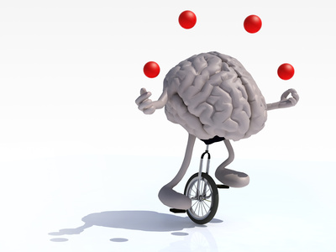
Pay attention to Working Memory
Working memory is limited.
It’s limited to approximately 7 pieces of information.
If a child’s working memory becomes overloaded they will likely run into difficulties.
Can lead children to withdraw
from their learning.
How can we help?

Slide 24
Teach children to use strategies that free up working memory space (write things down, verbalise thoughts, chunk items together)
Scaffold the work – break a task down – writing frames for ALL abilities
Use questions to direct the thinking of a child
Make children aware of what working memory is

Slide 25
Good mistakes/editing

Slide 26
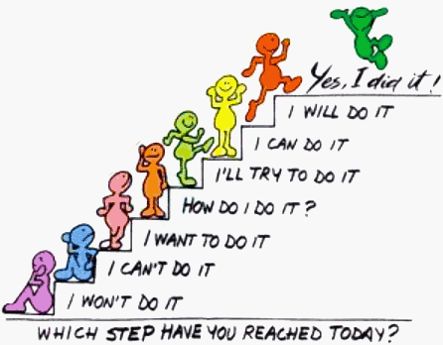

Slide 27
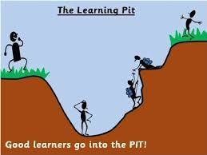

Slide 28
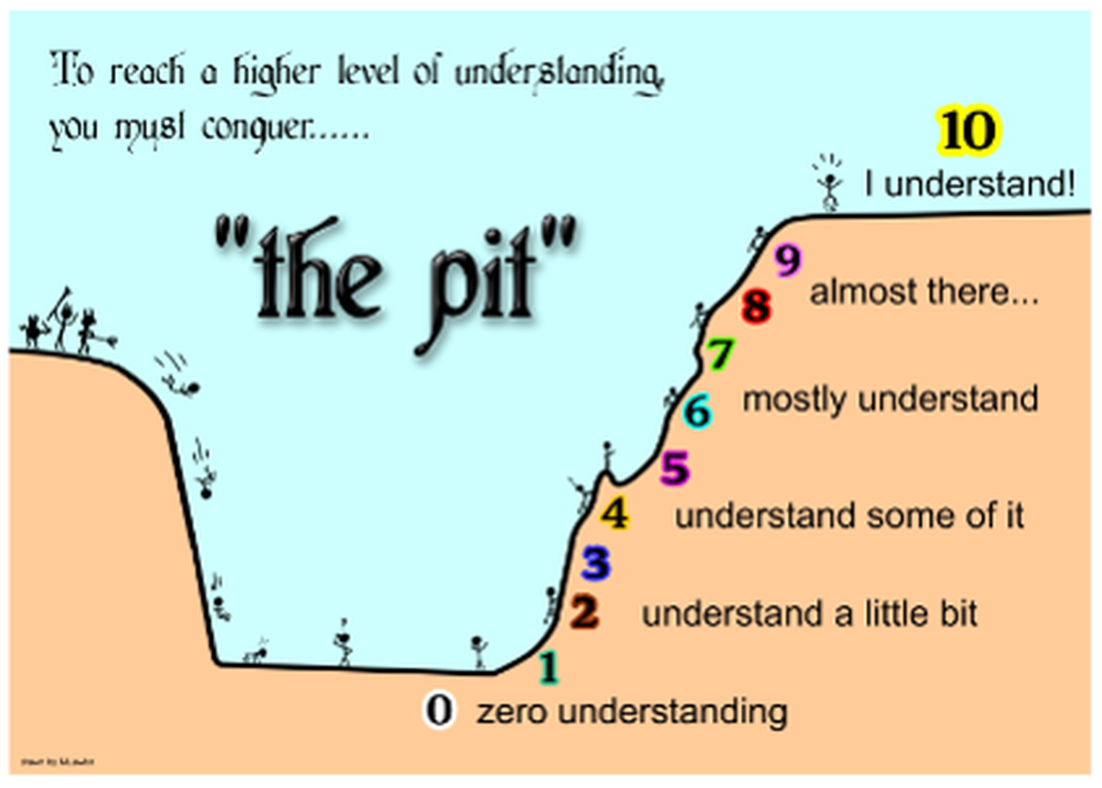

Slide 29
What can you do to help support your child at home with growth mindset?

Slide 30
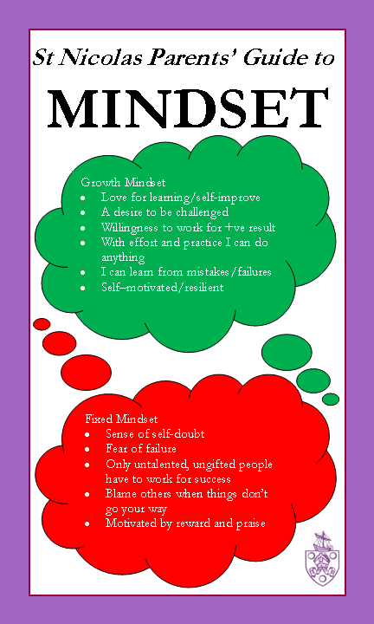

Slide 31
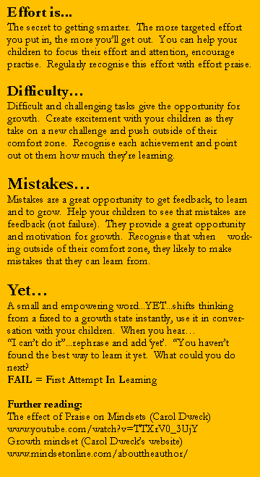

Slide 32
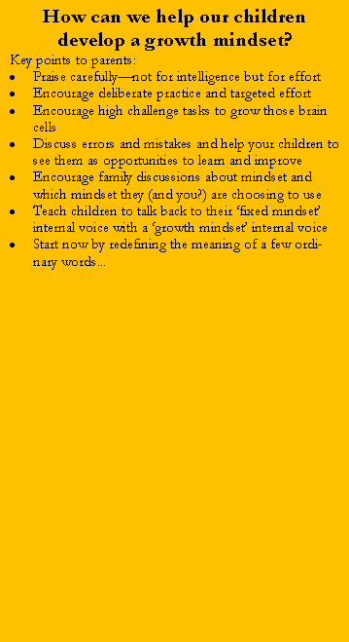
INTELLIGENT PRAISE
You’re so clever at…
You’re so intelligent at…
You’re lucky, you’re gifted at...and it’s so easy for you to…
Don’t worry if you didn't get a great result, did you get a better score than x child?
Ah...you made a mistake, how many times have we told you to get it right first time?
EFFORT PRAISE
I’ve noticed the effort you’re putting into…
All of your hard work and practise is resulting in progress in…
I’m proud of how committed you have been to learning…
Are you clear what you need to do to improve your learning next time?
You made a mistake that OK. You can learn from it

Slide 33
A few mind shifting tips for cultivating a growth mindset at home
HELP CHILDREN RECONNECT WITH A TIME WHEN THEY LEARNED SOMETHING NEW THAT WAS A CHALLENGE
Point out the developmental nature of ‘getting good’ - we all go through the process of making a lot of mistakes, practicing and then getting better.
HELP CHILDREN GET CURIOUS ABOUT MISTAKES
Help them reframe a mistake as new information or as a step in the process of learning. In addition, help them incorporate self-correction in their own learning process.
AVOID LABELS AND GIVE GROWTH MINDSET PRAISE
Don’t label yourself in ways that model a ‘fixed mindset’ (e.g. I’m a terrible cook….I was never good at Maths)
Praise and value effort, practise, sefl-correction and persistence
Don’t shelter your child from a failed task. Ask “What can you learn from this experience? What could you try differently next time?”
HELP CHILDREN TALK BACK TO NEGATIVE SELF-TALK WITH A GROWTH MINDSET VOICE
e.g I get better and better with practice this is hard, but will get easier
GET CURIOUS ABOUT YOUR CHILD’S WORK THROUGH QUESTIONS
How did you figure that out? What’s another way you could have done that? How many times did your try before it turned out that way? What could you try differently next time?
HELP CHILDREN LEARN TO HEAR THEIR OWN FIXED MINDSET ‘VOICE’
Some examples: “That guy is brilliant; he never tries and he gets it” “I got it wrong again, I’ll never get this”
Some children don’t even realise how fixed their mindset can be. Discuss and challenge their opinions and attitudes.

